Slide 1

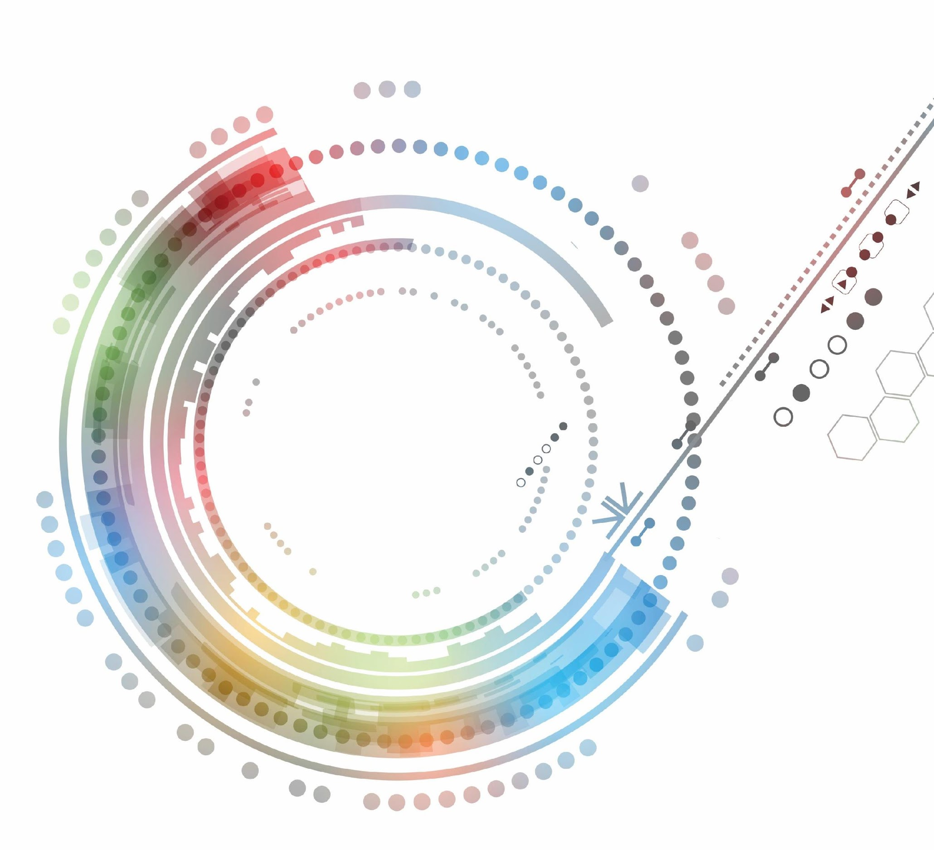
Foundations of Technology

Slide 2
Technological Inventions and Innovations
Unit 1: Technological Inventions and Innovations
Learning Cycle 4: Advertising and Marketing Effects on Technology

Slide 3
Big Idea
Many factors, including advertising, the strength of the economy, goals of the company, and fads determined by society, have an impact on the demand and design of technology.

Slide 4
Impacts of Technology
Technology directly affects society in four distinct areas because it solves practical problems and serves human needs.
Environmental
Economic
Social
Political

Slide 5
Impacts of Technology
Environmental – those that have a positive or negative effect on the natural environment.
Economic – those that have a financial impact on our society.
Social – how an invention or innovation improves or changes the way in which we live and work.
Political – how an invention or innovation influences political decisions and policies such as laws and regulations.

Slide 6

Trade-Offs
All technologies have both positive and negative effects other than those that were originally anticipated during the design phase.
Trade-offs are when a designer must make a choice between a positive and negative impact for a product.
VS.

Slide 7


Trade-Offs
Example: Chlorofluorocarbons (CFCs)
Highly praised in 1930 as a coolant for refrigeration units, aerosol propellants, and cleaning solvents.
In 1973 was found to be a leading agent in the depletion of the ozone, later banned in 2010 by developed nations.
Would you continue using CFCs?

Slide 8
Trade-Offs
Example: Clean Environment? Better Gas Mileage?
Automobile Design 1 – is designed to be cleaner and better for the environment.
Automobile Design 2 – is designed to get better fuel economy and reduce the dependence on foreign oil.
As a designer – taking into account these are 2 positive impacts – how would you decide?

Slide 9
Technological Advancement
Technological advancement is often the result of ideas, knowledge, and/or skills that are shared across technologies or academic disciplines.
The advancement of technology is directly related to the advancement of science and mathematics.
Technology directly impacts society because it solves practical problems and serves human needs.

Slide 10
Product Success
A number of different factors contribute to the design of and demand for various technologies:
Advertising
Strength of the Economy
Goals of a Company
Latest Trends

Slide 11
Advertising
There are three general themes for great advertisements:
Strategy
Creativity
Execution

Slide 12
Advertising
Strategy
A clearly crafted message that is communicated to a target audience for a specific purpose.
Creativity
Gets the attention of the audience while positively influencing the consumer.
Execution
The blending of strategy and creativity to clearly communicate an idea.

Slide 13
Advertising
Successful advertisements are:
Highly Targeted
Identifies a clear target audience
Solve a Problem
Demonstrates how the product can be used to solve a problem
Unique
Are authentic, creative, and capture the audience’s attention
Cause the Audience to Act
Create some type of connection with the audience

